Slide 1
BUILDING Autonomous Machines with Jetson: TOOLs & TUTORIALS
Embedded World
February 23-25, 2016

Slide 2
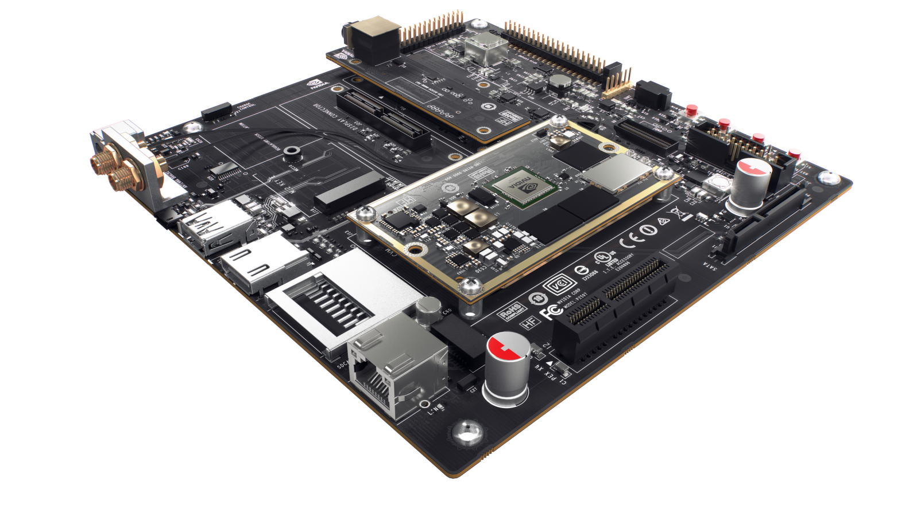
Jetson TX1 Developer Kit
Jetson TX1 Module
Developer Board
5MP Camera

Slide 3
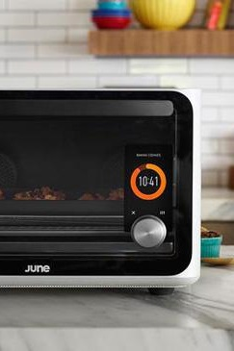
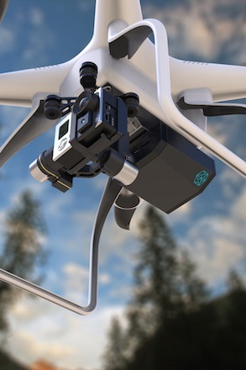
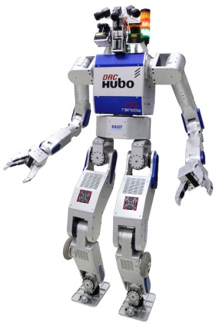
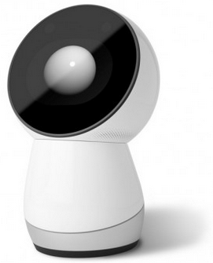
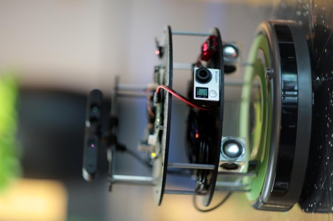
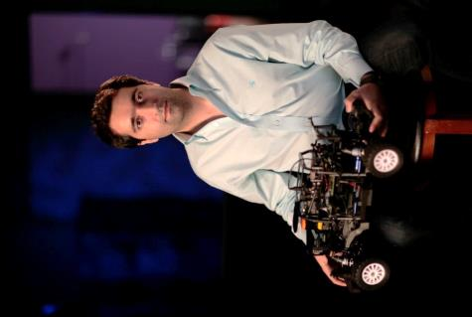
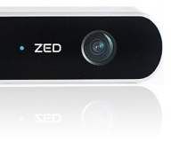
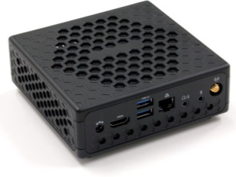

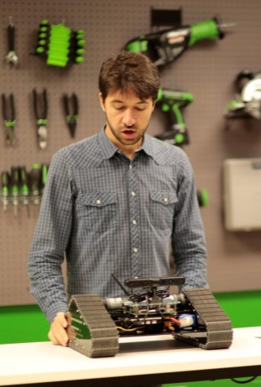
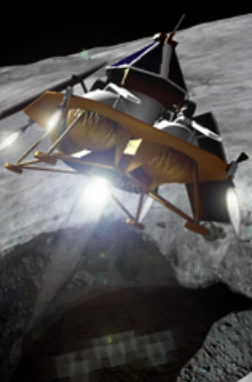
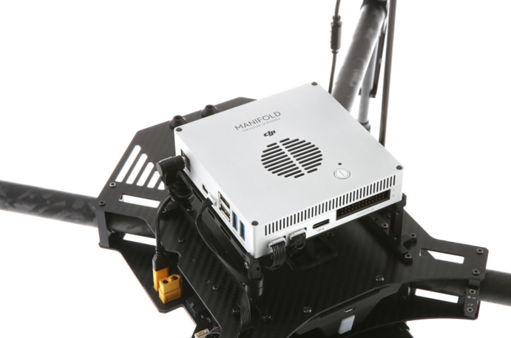
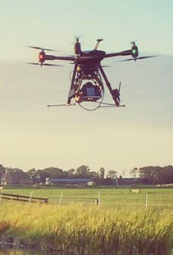
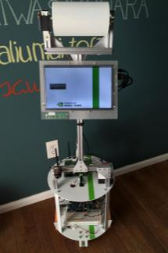
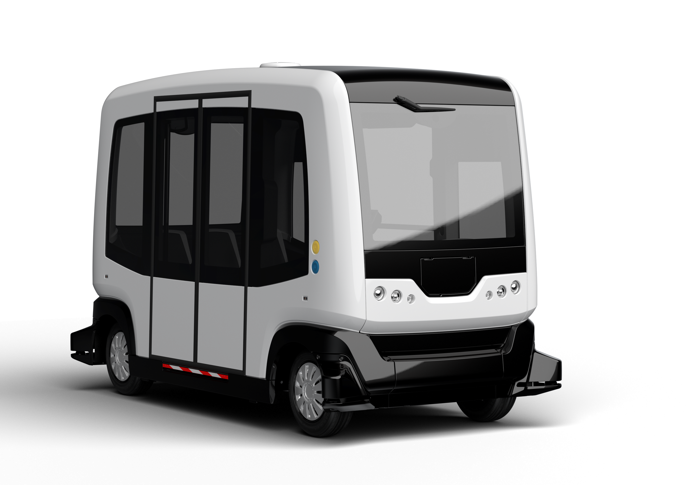
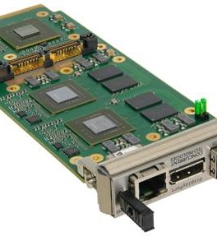
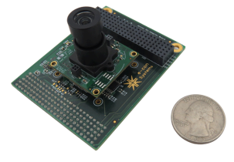
Jetson At the leading Edge Research Humanoids, Intelligent Appliances, Assistive and Medical Drones, Ground Robots, Submersibles
Notes:
These are all 3rd party platforms that integrate Jetson into their project or product. Jetson developers are deploying everything from research humanoids to social robots and self-flying drones, to autonomous spacecraft. The one thing that unites them all, is they each require maximum computational performance for onboard sensing in minimum size, weight, and power envelope.
---------
Jetson is NVIDIA’s platform for embedded visual computing. We launched Jetson a year-and-a-half ago with The Jetson TK1 Developer kit. We built it those people looking for the very best performance for visual computing in the embedded space. Researchers, OEMs, ISVs and IHVs, and Makers turn to Jetson when they need the best computer vision, the best graphics, the best GPU computing under 10W. You may have heard of examples. Jibo is the worlds first personal robot. Based on Jetson. Jibo has a camera so it can learn about you and your habits and helps organize, simplify, and enrich your life. The June oven was announced earlier this year: it uses computer vision and deep learning to help anyone improve their cooking abilities. And just this week DJI announced the Manifold, a Jetson-based computer vision box for the Matrice 100. From Products, to research, to ecosystem, Jetson is a powerful, efficient, and accessible platform. And by the way, we’re going to send you these slides and include references for what each of the above images is in case you’d like tolearn more.

Slide 4
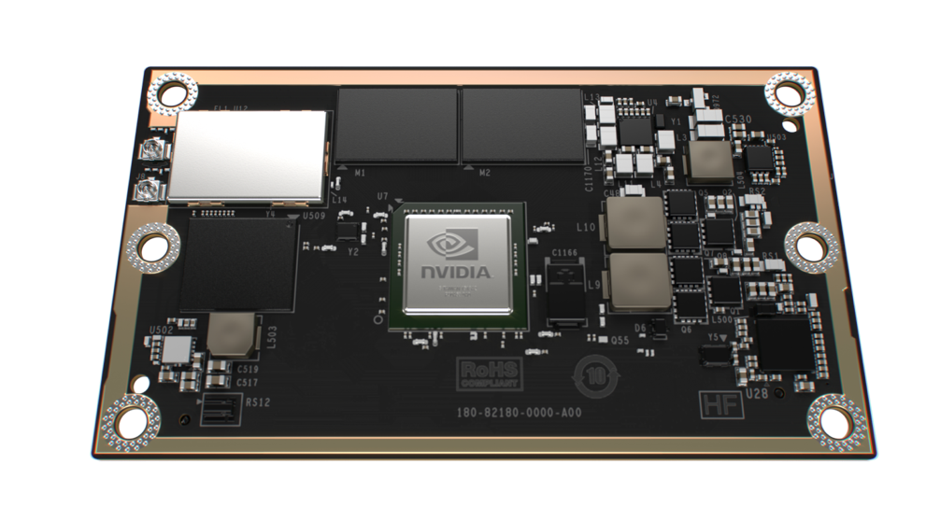
 | Jetson TX1
GPU | 1 TFLOP/s 256-core Maxwell
CPU | 4x 64-bit ARM A57 CPUs | 1.6 GHz
Memory | 4 GB LPDDR4 | 25.6 GB/s
Video decode | 4K 60Hz H.264
Video encode | 4K 30Hz H.264
CSI | Up to 6 cameras | 1400 Mpix/s
Display | 2x DSI, 1x eDP 1.4, 1x DP 1.2/HDMI
Wi-Fi | 802.11 2x2 ac
Networking | 1 Gigabit Ethernet
PCI-E | Gen 2 1x1 + 1x4
Storage | 16 GB eMMC, SDIO, SATA
Other | 3x UART, 3x SPI, 4x I2C, 4x I2S, GPIOs
Power | 10-15W, 6.6V-19.5VDC
Size | 50mm x 87mm
Jetson TX1
Notes:
With 256 CUDA-enabled Maxwell cores and over a teraflop of raw compute in only 10-15 watts power consumption, Jetson TX1 provides the ultimate in embedded performance and efficiency.
It has 64 bit ARM CPUs, 4 GB of LPDDR4 memory with bandwidth up to 25.6 GB/s. 16 GB of Flash storage, WiFi and bluetooth ready. Gigabit Ethernet. It’s 50mm x 87mm, slightly smaller in area than a credit card (obviously it’s bigger in the Z dimension). It interfaces with a carrier board over a 400 pin board to board connector, which brings out all of the high-speed and general purpose signals from the chip. Our customers will take Jetson TX1 and integrate it into their final products that have the exact form factor and interfaces that they need. We also provide a developer kit, which I’m going to talk about later.

Slide 5
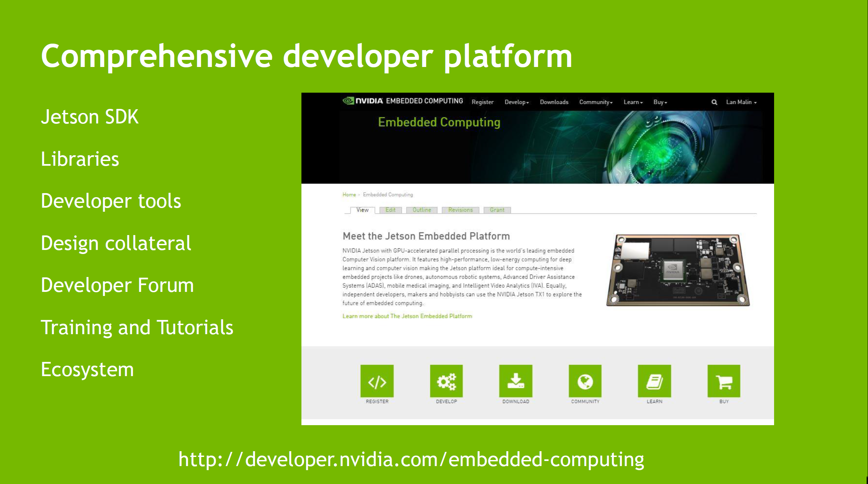
Notes:
Further, we have a developer-friendly website set up which contains all the docs and downloads. For Jetson TX1, we released thousands of pages of documentation to go along with the board. It’s a sea change for vendors to offer open-access into the depths of their historically guarded SoC’s. To NVIDIA, it’s important to get this technology into the hands of developers everywhere without exception.

Slide 6
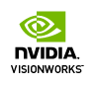
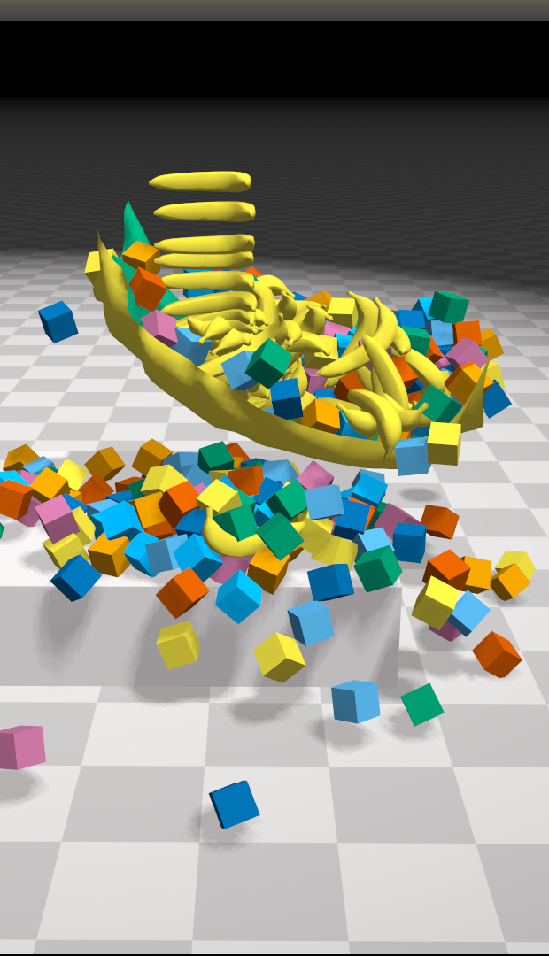
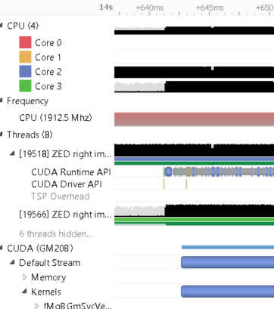
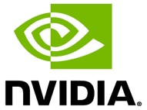




Jetson Linux SDK
Deep Learning and
Computer Vision
GPU Compute
Developer Tools
NVTX
NVIDIA Tools eXtension
Debugger | Profiler | System Trace
Notes:
The Jetson BSP is built upon Linux, currently Ubuntu 14.04 LTS, with the full support of CUDA Toolkit and all of it’s associated libraries. In addition, there’s VisionWorks and a suite of performance profiling, analysis, and debugging tools for the Tegra SoC.

Slide 7











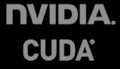







Jetson SDK: The Details
Vertically
Integrated
Packaages
Vertically Integrated Packages
CUDA
OpenGL
Tools
Machine
Learning
Vision
Source
code editor
cuFFT
CUDA Math Library
Debugger
Compute
cuBLAS
NPP
cuSPARSE
Graphics
Profiler
cuRAND
Thrust
cuSolver
System
Trace
Linux for
Tegra
V4L2
libjpeg
NVTX
NVIDIA Tools eXtension
Jetson TX1
Notes:
Here’s a look at the API’s you get out-of-the-box. Jetpack, our board flashing tool, will optionally install these upon a fresh image load. There’s everything you need to get started and more, from OpenCV4Tegra to cuDNN and Caffe.

Slide 8

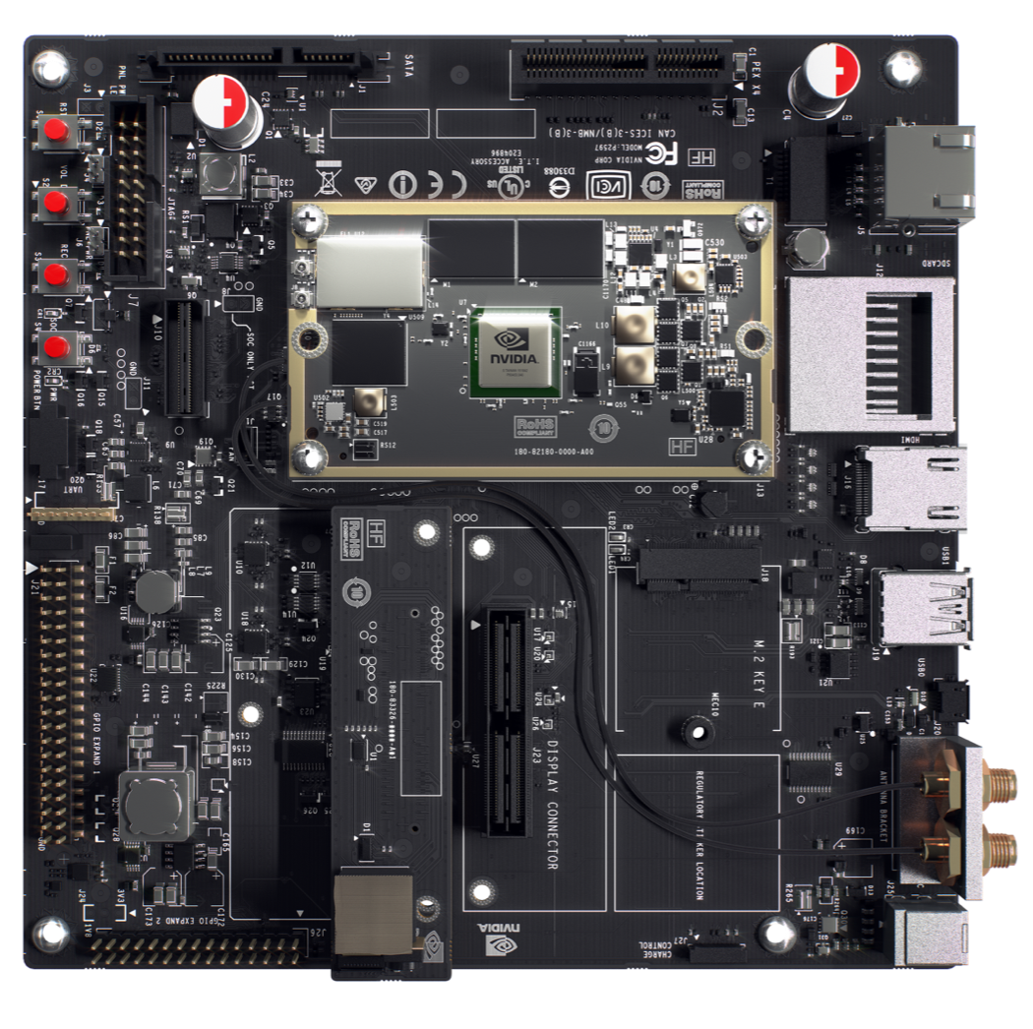
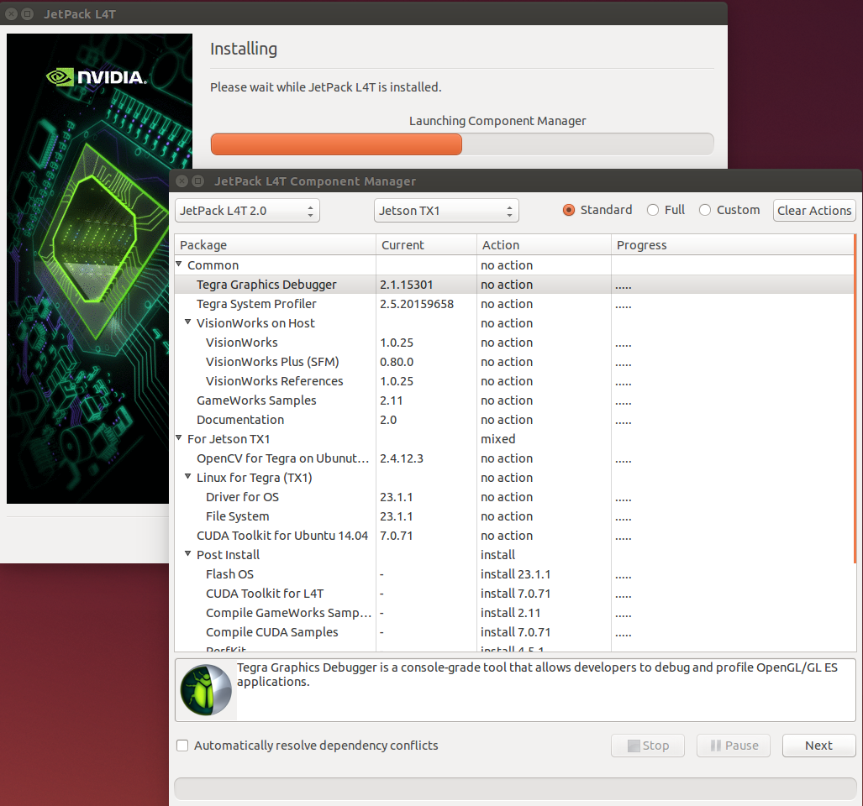
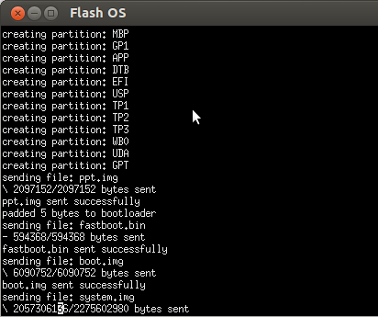
JETPACK
Notes:
Jetpack: installs it all
Screenshots/ect.

Slide 9
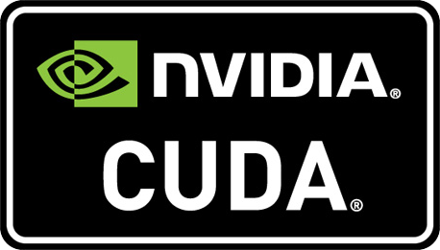
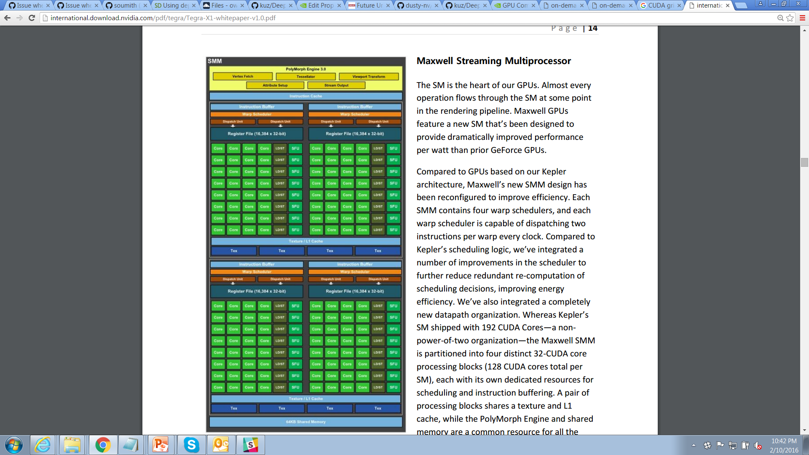
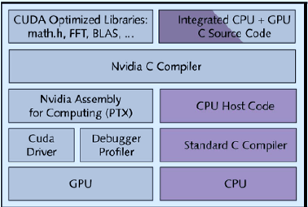
CUDA TOOLKIT HELLO WORLD
__global__ void my_kernel() {
printf(“Hello World from GPU!\n”);
}
int main()
{
printf("Hello World from CPU!\n");
my_kernel<<<1,1>>>(); return 0; }
$ nvcc hello_world.cu $ ./a.out Hello World from CPU! Hello World from GPU!

Slide 10
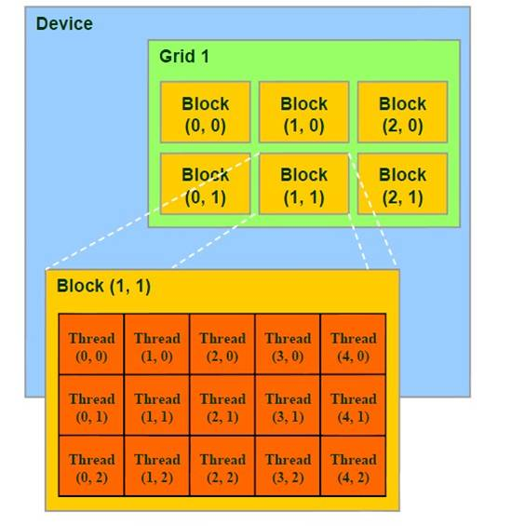
CUDA TOOLKIT HELLO WORLD
__global__ void my_kernel() {
printf(“GPU blk %i thread %i %i\n”, blockIdx.x, threadIdx.x, threadIdx.y);
}
int main()
{ const dim3 threadsPerBlock(2,2);
const dim3 blocksPerGrid(2);
my_kernel<<<threadsPerBlock, blocksPerGrid>>>(); return 0; }
$ nvcc hello_world.cu $ ./a.out GPU block 0 thread 0 0 GPU block 0 thread 0 1 GPU block 0 thread 1 0 GPU block 0 thread 1 1 GPU block 1 thread 0 0 GPU block 1 thread 0 1 GPU block 1 thread 1 0 GPU block 1 thread 1 1

Slide 11
__global__ void gradient_kernel( float* input, float2* output, int width, int height )
{
const int x = blockDim.x * blockIdx.x + threadIdx.x;
const int y = blockDim.y * blockIdx.y + threadIdx.y;
if( x == 0 || y == 0 || x >= width-1 || y >= height-1 )
return; // for border pixels, don’t access invalid areas
const float dx = 0.5f * input[y*width+x+1] - 0.5f * input[y*width+x-1];
const float dy = 0.5f * input[(y+1)*width+x] - 0.5f * input[(y-1)*width+x];
output[y*width+x] = make_float2(atan2f(dy,dx), // orientation (angle) sqrtf(dx*dx+dy*dy)); // magnitude }
const int width = 1920; const int height = 1080;
const dim3 blockDim(16,16); // # of threads per block
const dim3 gridDim(imageSize.x / blockDim.x, imageSize.y / blockDim.y);
gradient_kernel<<<blockDim, gridDim>>>( input, output, width, height );

Slide 12
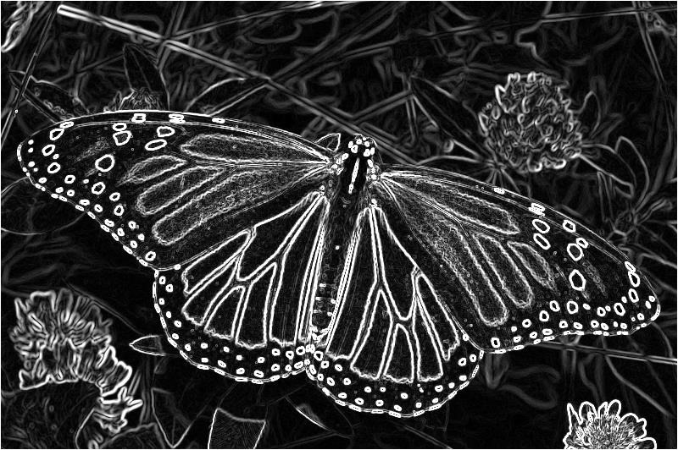
__global__ void gradient_kernel( float* input, float2* output, int width, int height )
{
const int x = blockDim.x * blockIdx.x + threadIdx.x;
const int y = blockDim.y * blockIdx.y + threadIdx.y;
if( x == 0 || y == 0 || x >= width-1 || y >= height-1 )
return; // for border pixels, don’t access invalid areas
const float dx = 0.5f * input[y*width+x+1] - 0.5f * input[y*width+x-1];
const float dy = 0.5f * input[(y+1)*width+x] - 0.5f * input[(y-1)*width+x];
output[y*width+x] = make_float2(atan2f(dy,dx), // orientation (angle) sqrtf(dx*dx+dy*dy)); // magnitude }
const int width = 1920; const int height = 1080;
const dim3 blockDim(16,16); // # of threads per block
const dim3 gridDim(imageSize.x / blockDim.x, imageSize.y / blockDim.y);
gradient_kernel<<<blockDim, gridDim>>>( input, output, width, height );
Paste NVPROF timings

Slide 13
texture<float, 2, cudaReadModeElementType> gradientTex; // input grayscale texture __global__ void gradient_kernel_tex( float2* output, int width, int height )
{
const int x = blockDim.x * blockIdx.x + threadIdx.x;
const int y = blockDim.y * blockIdx.y + threadIdx.y;
const float dx = 0.5f * tex2D(gradientTex,x+1,y) - 0.5f * tex2D(gradientTex,x-1,y);
const float dy = 0.5f * tex2D(gradientTex,x,y+1) - 0.5f * tex2D(gradientTex,x,y-1);
output[y*width+x] = make_float2(atan2f(dy,dx), // orientation (angle) sqrtf(dx*dx+dy*dy)); // magnitude }
cudaBindTexture2D(NULL, gradientTex, input, cudaCreateChannelDesc<float>(), width, height, width * sizeof(float)); // bind to texture gradient_kernel_tex<<<blockDim, gridDim>>>( input, output, width, height ); cudaUnbindTexture(gradientTex); // unbind from texture

Slide 14
texture<float, 2, cudaReadModeElementType> gradientTex; // input grayscale texture __global__ void gradient_kernel_tex( float2* output, int width, int height )
{
const int x = blockDim.x * blockIdx.x + threadIdx.x;
const int y = blockDim.y * blockIdx.y + threadIdx.y;
const float dx = 0.5f * tex2D(gradientTex,x+1,y) - 0.5f * tex2D(gradientTex,x-1,y);
const float dy = 0.5f * tex2D(gradientTex,x,y+1) - 0.5f * tex2D(gradientTex,x,y-1);
output[y*width+x] = make_float2(atan2f(dy,dx), // orientation (angle) sqrtf(dx*dx+dy*dy)); // magnitude }
cudaBindTexture2D(NULL, gradientTex, input, cudaCreateChannelDesc<float>(), width, height, width * sizeof(float)); // bind to texture gradient_kernel_tex<<<blockDim, gridDim>>>( input, output, width, height ); cudaUnbindTexture(gradientTex); // unbind from texture
Paste NVPROF timings — compare texture vs. non-textured

Slide 15
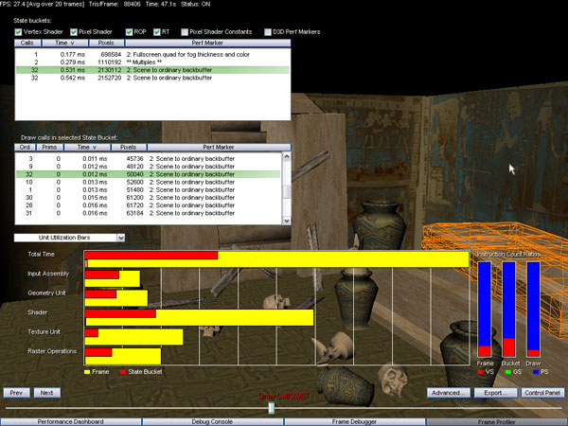
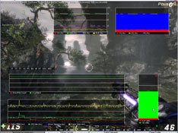
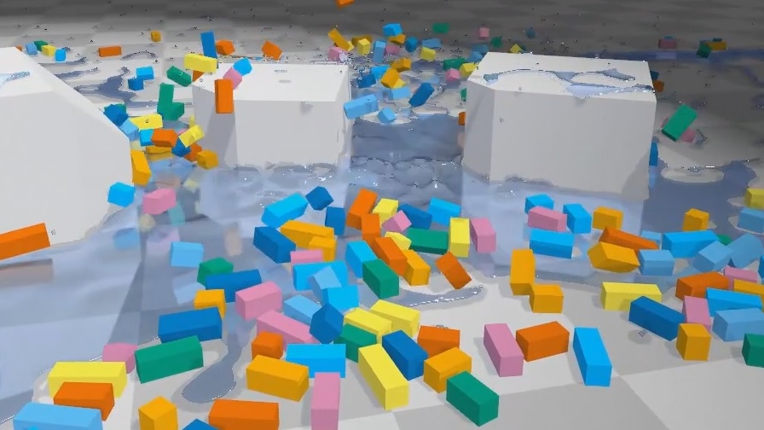
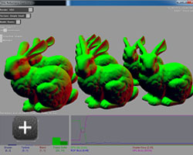
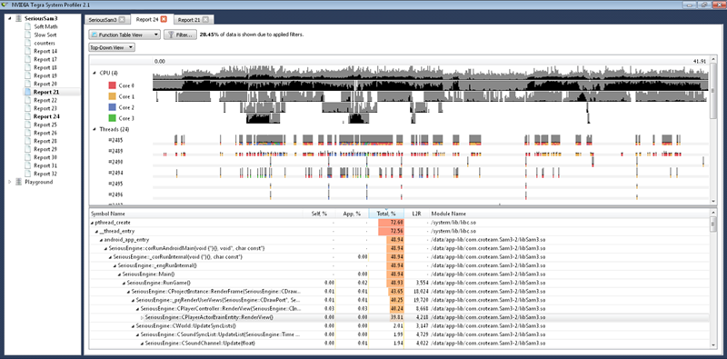
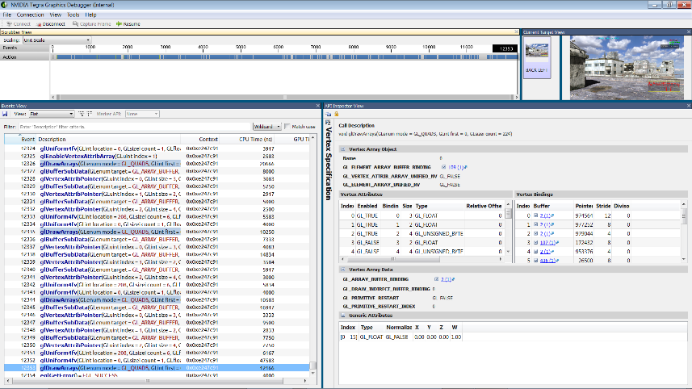
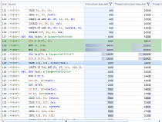
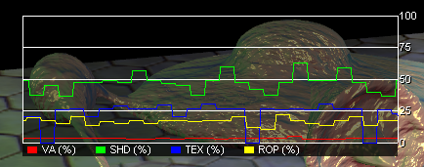
Tegra system profiling tools

Slide 16
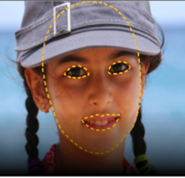
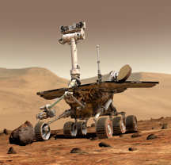
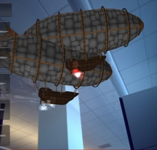
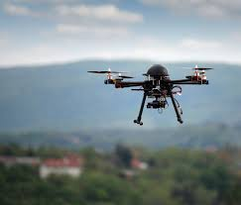
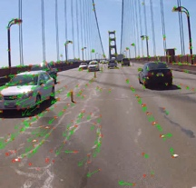
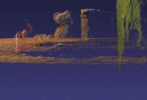
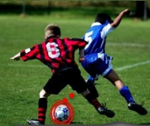
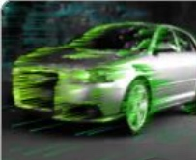
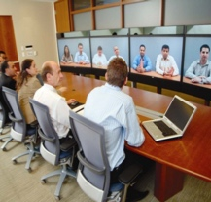
VisionWorks™
CUDA-accelerated Computer Vision Toolkit
Full OpenVX 1.1 implementation
Custom extensions
Easy integration with existing CV pipelines
Robotics
Augmented Reality
Drones
Example
Applications
Applications
Feature Tracking
Structure from Motion
Object Tracking
Dense Optical Flow
VisionWorks
VisionWorks™ API + FrameWorks
CUDA
VisionWorks™
Toolkit
IMAGE ARITHMETIC
Absolute Difference Accumulate Image
Accumulate Squared
Accumulate Weighted
Add / Subtract / Multiply
Channel Combine
Channel Extract
GEOMETRIC TRANSFORMS
Affine Warp +
Perspective Warp
Flip Image
Gaussian Pyramid
Remap
Scale Image
Features
Canny Edge Detector
Fast Corners +
Fast Track
Harris Corners +
Harris Track
Hough Circles
Hough Lines
Jetson TX1
Notes:
High-level VisionWorks primitives include:
FAST corner extraction + matching
LTK optical flow
SLAM
Stereo block matching
and more!

Slide 17
VisionWorks™ Software Stack
User Code
VisionWorks Toolkit
VisionWorks Sample Applications
Feature Tracking, Camera Capture
VisionWorks
API Extensions
VisionWorks
Framework Extensions
OpenVXTM API
OpenVXTM Framework
User
CUDA Acceleration Framework
Khronos
Tegra, Kepler/Maxwell GPU
NVIDIA
Notes:
VisionWorks Software Stack builds on top of CUDA acceleration framework, and all of the API is fully accelerated with CUDA. VisionWorks is designed for Tegra, but supported on Kepler or later generation desktop grade GPUs as well.
VisionWorks Toolkit implements entire Khronos OpenVX 1.0.1 framework and API specifications. In addition to standard API, the library also contains framework and API extensions, enriching the library with most frequently requested features.
VisionWorks Toolkit also contains source samples. The samples demonstrate usage of the framework and the computer vision APIs through visual rendering of the output from computer vision processing applied to the input frame source. The users can freely modify and customize these sample applications to their needs.
While developing custom applications, the developers can include different libraries and add calls to them, implement their own CUDA kernels and intermix with VisionWorks API. In fact, VisionWorks toolkit includes an optional source sample that demonstrates use of OpenCV, NPP and OpenVX API calls in one sample application.

Slide 18
Visionworks™ Primitives
IMAGE ARITHMETIC
Absolute Difference
Accumulate Image
Accumulate Squared
Accumulate Weighted
Add / Subtract / Multiply
Channel Combine
Channel Extract
Color Convert +
CopyImage
Convert Depth
Magnitude
Not / Or / And / Xor
Phase
Table Lookup
Threshold
FLOW & DEPTH
Median Flow
Optical Flow (LK)
Semi-Global Matching
Stereo Block Matching
GEOMETRIC TRANSFORMS
Affine Warp +
Warp Perspective +
Flip Image
Remap
Scale Image +
FILTERS
BoxFilter
Convolution
Dilation Filter
Erosion Filter
Gaussian Filter
Gaussian Pyramid
Laplacian3x3
Median Filter
Scharr3x3
Sobel 3x3
FEATURES
Canny Edge Detector
Fast Corners +
Fast Track
Harris Corners +
Harris Track
Hough Circles
Hough Lines
ANALYSIS
Histogram
Histogram Equalization
Integral Image
Mean Std Deviation
Min Max Locations
All OpenVX Primitives
NVIDIA extensions
+ type/mode extension by NVIDIA
NVIDIA extension primitives
Notes:
VisionWorks Toolkit implements all of OpenVX primitives, defined in 1.0.1 version of the standard specification, and an additional 10 NVIDIA defined extensions.
VisionWorks primitives can be categorized as
Image Arithmetic functions,
Flow and depth processing functions,
Geometric transforms,
Filters,
Features and
Analysis functions.
The functions marked in green are NVIDIA extensions. The functions marked with “+” are OpenVX defined functions further extended by NVIDIA for different data types and modes of operation.
Vision API is fully accelerated with CUDA. Part of the Vision API is also accelerated on the Tegra CPUs with NEON and multithreading.

Slide 19
TX1
CPU 1.9GHz, GPU 996MHz, MC 1.6GHz
OpenCV 2.4.10
VisionWorks 1.0
L4T 23.1 CUDA 7.0
Score: Geometric mean of all CV primitives performance measured at all available parameters for all overlapping primitives, measured for images
sizes 720p and larger.

Slide 20
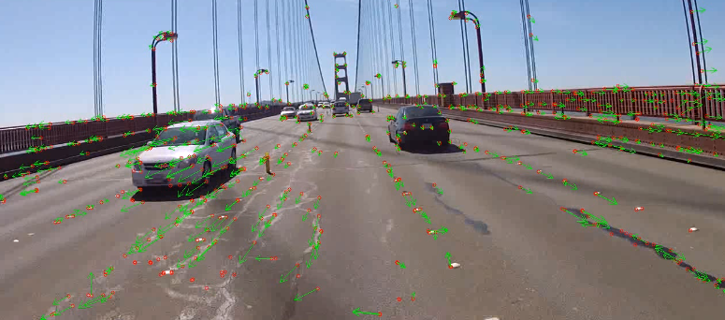



VisionWorks™ Sample Pipelines
Feature Tracker
Stereo Depth Extraction
OpenCV-NPP-OpenVX Interop
Hough Lines & Circles
+ Platform specific samples (available only on certain platforms)
Camera Capture, OpenGL interop, Video playback
Notes:
On top of the VisionWorks software stack sits the VisionWorks sample applications. The sample applications are available as source code and they are intended to help the developers get familiar with the platform, as well as to get them familiar with the library.
Here are some of the sample applications delivered with the VisionWorks toolkit package:
A Feature Tracker sample that demonstrates detection of feature points and tracking of the feature points across frames and rendering the motion displacement vectors overlayed on the input video source.
Stereo Depth Extraction Sample that extracts depth from stereo pair
OpenCV-NPP-OpenVX interoperability optional sample. This sample is enabled only when OpenCV4Tegra is installed on the system and demonstrates how to mix and match libraries for computer vision development.
Hough Circle and Lines Sample, that demonstrate circle and line detection
The source samples use video files or camera capture, process the frames using VisionWorks library API and renders the results on display. There are additional samples that show particular media acceleration applicable for a specific platform; these samples will be installed only on the targeted plarforms.

Slide 21





Feature Tracking Sample
OpenVX Graph
Pyr_{t-1}
Pyr_{t}
Camera/image/video
Input data
Pyr_{t}
Rendering/Output
RGB
frame
YUV
frame
Gray
frame
Color Conversion
Channel Extract
Image
Pyramid
Optical Flow
Harris Track
Array of
keypoints
Array of
keypoints
Pts_{t}
Notes:
Now, let’s take a look at a sample pipeline form VisionWorks in more detail.
The feature tracker takes the features found in the previous image and looks for them in the current image. It does this in an image “pyramid” so that it can find the features quickly at the low resolution, and then locate them more accurately as it goes down the pyramid.
First the input image is converted from RGB to YUV and the Y channel (gray scale) is extracted.
Then an image pyramid is constructed from the current image.
Features found in the previous pyramid are found in the current one using the OpticalFlowPyrLK primitive.
Harris corners are then found in the current frame to provide the starting locations for the search in the next frame.
Finally, the image is displayed with the features highlighted.

Slide 22

pyr/LTK OPTICAL FLOW
Feature Tracking Sample
Notes:
After installing the visionworks-dev package, the samples applications will be placed in /usr/share/visionworks/source. Using sample installation script located in this directory, the sample applications can be installed anywere on the device and then after compilation and execution the sample can be run.
On certain platforms, pre-built binaries are provided along with the source samples.
The screenshot in this slide is captured from feature tracker sample during its execution.
Where applicable, the samples can be tuned and modified to cover different use-cases and applications of the algorithms. Some of the samples include instructions on hints and guidance on customization of the algorithm to address different use cases.
Once again, the samples are intended to help already challenged embedded computer vision developers to come up to speed in developing their applications. The samples also improve the learning curve for newcomers to the VisionWorks technology.

Slide 23
Samples
const float k = 0.04f;
const float threshold = 110;
const int cell_size = 18;
vx_array corners = vxCreateArray(context, VX_TYPE_KEYPOINT, 3000);
nvxuHarrisTrack(context, src, corners, NULL, NULL, k, threshold, cell_size, NULL);
Harris Corners
Feature Tracking Sample
Notes:
After installing the visionworks-dev package, the samples applications will be placed in /usr/share/visionworks/source. Using sample installation script located in this directory, the sample applications can be installed anywere on the device and then after compilation and execution the sample can be run.
On certain platforms, pre-built binaries are provided along with the source samples.
The screenshot in this slide is captured from feature tracker sample during its execution.
Where applicable, the samples can be tuned and modified to cover different use-cases and applications of the algorithms. Some of the samples include instructions on hints and guidance on customization of the algorithm to address different use cases.
Once again, the samples are intended to help already challenged embedded computer vision developers to come up to speed in developing their applications. The samples also improve the learning curve for newcomers to the VisionWorks technology.

Slide 24



Samples
const float rho = 1.0f;
const float theta = 1.0f;
const float minVotes = 100.0f; const float minLength = 25.0f;
nvxuHoughSegments(context, src, lines_out, rho, theta, minVotes, minLength, 2.0f, NULL );
Hough Segments
Hough Demo
Hough Lines/Circles
Notes:
After installing the visionworks-dev package, the samples applications will be placed in /usr/share/visionworks/source. Using sample installation script located in this directory, the sample applications can be installed anywere on the device and then after compilation and execution the sample can be run.
On certain platforms, pre-built binaries are provided along with the source samples.
The screenshot in this slide is captured from feature tracker sample during its execution.
Where applicable, the samples can be tuned and modified to cover different use-cases and applications of the algorithms. Some of the samples include instructions on hints and guidance on customization of the algorithm to address different use cases.
Once again, the samples are intended to help already challenged embedded computer vision developers to come up to speed in developing their applications. The samples also improve the learning curve for newcomers to the VisionWorks technology.

Slide 25
Samples
const float minRadius = 1.0f;
const float maxRadius = 25.0f;
const float minDist = 10.0f; const float threshold = 100.0f;
nvxuHoughCircles(context, src, dx, dy, circles_out, NULL, minDist, minRadius, maxRadius, threshold );
Hough Lines
Hough Demo
Hough Lines/Circles
Notes:
After installing the visionworks-dev package, the samples applications will be placed in /usr/share/visionworks/source. Using sample installation script located in this directory, the sample applications can be installed anywere on the device and then after compilation and execution the sample can be run.
On certain platforms, pre-built binaries are provided along with the source samples.
The screenshot in this slide is captured from feature tracker sample during its execution.
Where applicable, the samples can be tuned and modified to cover different use-cases and applications of the algorithms. Some of the samples include instructions on hints and guidance on customization of the algorithm to address different use cases.
Once again, the samples are intended to help already challenged embedded computer vision developers to come up to speed in developing their applications. The samples also improve the learning curve for newcomers to the VisionWorks technology.

Slide 26
Samples
TODO: (upgrade Jetpack 2.1) VisionWorks 1.1 object tracker stereo block matching?
Object Tracking Sample
Notes:
After installing the visionworks-dev package, the samples applications will be placed in /usr/share/visionworks/source. Using sample installation script located in this directory, the sample applications can be installed anywere on the device and then after compilation and execution the sample can be run.
On certain platforms, pre-built binaries are provided along with the source samples.
The screenshot in this slide is captured from feature tracker sample during its execution.
Where applicable, the samples can be tuned and modified to cover different use-cases and applications of the algorithms. Some of the samples include instructions on hints and guidance on customization of the algorithm to address different use cases.
Once again, the samples are intended to help already challenged embedded computer vision developers to come up to speed in developing their applications. The samples also improve the learning curve for newcomers to the VisionWorks technology.

Slide 27

DEEP LEARNING AND AUTONOMY

Slide 28


At the Frontier of autonomous machines
New use cases demand autonomy
Onboard sensing and deep learning, enable autonomy
GPUs deliver superior performance and efficiency
x₁
x₂
x₃
x₄
Notes:
We’re collectively here today because I believe many of us share a vision about the ubiquity of AI and autonomy coming in the 21st century. NVIDIA’s role in this is to provide accessible, high-performance visual computing platforms to enable the work of developers everywhere. And like many of you, we’re always searching for the latest and greatest empowering tech out there.
One place we can look is GPUs. GPUs provide the nexus between performance and programmability. They achieve greater FLOPS per watt per dollar of cost and development time.

Slide 29
How far has autonomy come?
ImageNet classification accuracy
Deep Learning on GPUs
Notes:
With the advent of vastly accelerated training, and the growing availability of more and more example data for supervised learning, the accuracy of networks has ramped up in recent past. Since GPUs came on the scene in 2012, error rates have been trending downwards at a rate much faster than seen in the field previously. And for the first time last year, a computer classifier was able to outperform a human at classifying image content. And the 94.9% figure for humans, these were no ordinary humans. They were dataset annotators who clearly were skilled in the area. This was run using the ImageNet challenge competition that various companies and institutions enter their networks into.
---
Deep Learning is a neural-network based approach to machine learning. What distinguishes it from previous approaches is that it enables you to train very large data sets. This results is much more accurate performance for things like image classification, natural language processing, and medical diagnosis. There are three things that make this possible. First is the existence of large datasets for training. With the proliferation of cameras and big data solutions, there is simply more data for training neural networks. The second is new algorithms that train the networks far more efficiently. And the third is GPUs. These new algorithms are parallel in nature, and you need a general purpose, highly parallelized architecture to take advantage of them. As a proof point of the power of deep learning, there is a challenge known as the imagenet challenge that started 6 years ago. The challenge is to classify objects in images, like cocker spaniels, bicycles, etc. When it started in 2010 everybody was using traditional computer vision approaches, and the accuracy was only 72%. That means that 28% of the time the computer wrongly identified the object in the image. Humans have an error rate of about 5% by the way. After a year of optimization and improvements they managed to eek out another 2 percentage points. Deep learning arrived on the scene in 2012 as a new approach to image classification. In one year they reduced error rates by nearly 40%, and every year that continued to improve. This year both Google and Microsoft announced deep-learning based approaches that beat human performance on the Imagenet challenge. Sometimes I have to step back and remind myself what an incredible result that is. What does a world look like where computers can understand visual data better than humans.
So I don’t want to spend too much time on the background of deep learning, and NVIDIA has a lot of great information posted on Deep Learning, but the key points I want to make are this:
Deep Learning is enabling people to solve problems in computer vision and related areas that were previously unsolvable.
Everyone who is doing serious deep learning is using GPUs.

Slide 30


Object Classification
Segmentation
Collision Avoidance
3D Reconstruction
Localization/Mapping
Notes:
So what does this mean for autonomous machines? With deep learning, they are able to extend their own capabilities and provide inference for themselves. And this isn’t just limited to the 2D image classification that you’ve seen of late. There’s ground-breaking work going on, right here at CMU even, to extend the paradigm further into 3D and provide terrain segmentation, collision avoidance, and refined SLAM on the point cloud. And with RNNs and LSTMs coming into vogue, there’s practically no limit to onboard intelligence for higher-level learning and connectivity of conceptual semantics, i.e. the ability to infer ideas and concepts. And with the training/eval loop closing to the point of on-the-fly learning onboard the platform, the possibilities are truly exciting.

Slide 31




Machine Learning using Deep Neural Networks
Today’s Largest Networks:
~10 layers
1B parameters
10M images
~30 Exaflops
~30 GPU days
Human brain has trillions of parameters – 1,000 more.
Input
Result
Notes:
Let’s take a look at what’s driving a lot of the activity in this space. A big part of the capabilities of Jetson TX1 are around providing onboard inference and deep learning. I’m sure by now, everybody is familiar with, or has at least heard of, deep learning. In recent years there’s been a resurgence of activity in the area of neural-networks, enabled by accelerated training on large GPUs like NVIDIA’s Tesla and TitanX. In fact, the training has become so accelerated, it allows scientists to nest and pipeline several highly-complex networks, coining the phrase “deep” learning. What used to take weeks or months to train can now be trained on GPUs in hours or in a day. We still have a long way to go before we reach the computational complexity and efficiency of the human brain, or most biological nervous systems for that matter, but we’re getting there.
------
Recently however there’s been a revival of an old approach but with a few new twists – Neural Networks
Proposed in the 1950s
Boom-bust cycles of hype/disappointment, but incremental progress
Two things changed:
1) More sophisticated “deep” models with levels of abstraction
2) Availability of more training data
Let’s use face recognition as an example to illustrate the approach
From low-level features (edges) to higher levels of abstraction (facial features) to highest level of abstraction (complete faces)
Identifies features that aren’t intuitive – lets discriminatory features emerge from the data
Today’s largest networks train for weeks, and consume massive amounts of computational cycles
Takeaways – a lot of interesting properties for this approach
Not use-case specific – nothing in the algorithm assumes the data was image-based
Robust – lots of research showing resilience to errors and noise
Scalable – results improve with a) more training data, b) large models (more parameters)
Successful – ultimately nobody would care if it didn’t work better than other approaches

Slide 32

Train, then Deploy your Neural networks
Programming Approaches
Classified Object!
Camera Inputs
Training: Server, GRID, DIGITS
Inference: Embedded (Jetson)
Solver
Network
Trained Deep Neural Net Model
Data Scientist
Notes:
Training isn’t the only aspect of deep learning that GPUs are accelerating. In the field, developers are deploying Jetson to host the runtime evaluation and inference capability onboard, as opposed to in the cloud. This decreases or eliminates the lag between events occurring in the environment and the response of the autonomous machine. You can quickly train your network on a larger NVIDIA GPU and then deploy that network on the size, weigh, and power-efficient Jetson module. Also not pictured here, but a lot of times Jetson is also used on the front-end data capture for the training data, because it contains high-end H.265 video encoders and SATA and PCIe interfaces for high-speed storage. And down the road, we are shortening the loop between collection, training, and inference by exploring onboard on-the-fly learning in realtime and alternative neural networks such as RNNs and LSTMs, which are Turing complete and can essentially encode an entire complex program in the network.
-----
So what does that mean for autonomous machines? Most of what I’ve talked about so far pertains to big GPUs in the cloud or in high performance workstations. There’s actually a great story here for autonomous machines, and I’ll explain why. There are two parts of the deep learning problem. The first is training. You show the computer lots of data, for instance tens of thousands of images of cocker spaniels and bicycles. This can take hours or days and runs on a server, like a product that NVIDIA sells called the Digits Devbox, but when its done you have a network that knows what these things look like. You can now show it new images that it has never seen before, and it can tell you what they are. This is inference, the second part of the problem. And it turns out that inference, while still computationally intensive, can fit in a Jetson TX1. You train your network on Digits, or on AWS, or whatever you preferred GPU-enabled solution is. You deploy your network onto Jetson TX1. Now your drone, your robot, your smart security system is recognizing animals, vehicles, and people, doing natural language processing, or any of the other applications for which deep learning is proving a great solution.
To clarify: dotted lines…location of camer inputs. REWORK!!!!

Slide 33


cuDNN
CUDA-accelerated Deep Learning library
Supports industry-standard frameworks:
Out-of-the-box speedups of neural networks:
For both Inference and Training:
Your Application
(dog breed detector, for example)
Frameworks
cuDNN
CUDA
Jetson TX1 // Tesla/Titan/GRID
Notes:
Couple of things I want to highlight from the Jetson SDK. This is a high performance platform and we make it easy…

Slide 34


Slide 35

DEEP VIZ TOOLBOX

Slide 36


IMAGE CAPTIONING WITH NEURALTALK2

Slide 37


PLAYING ATARI WITH DEEPMIND
From Pixels to Actions: Human-level control through Deep Reinforcement Learning
Notes:
Deep reinforcement learning network achieves superhuman arcade performance by learning to play the game from nothing but the video inputs. Google’s DeepMind Deep Q-Learner controls the Atari joystick inputs directly to control the outcome of the game.

Slide 38



END-To-END DEEP LEARNING FOR SELF-CONTROL
Sensory Inputs
Inference
user application
Long-term nav
Recognition
Perceptron
Short-term nav
RNN
Goal/reward function
Motor PWM
Notes:
Learning to operate on-the-fly and gain true autonomy,
for enabling self-driving robots (and self-flying drones) to adapt and learn from experience.
Benefits navigating complex, unstructured environments, indoor & outdoor
Training for broad behaviors & tasks, adapting to changing conditions, autolanding, ect.
Before deploying high-level user functions like facial recognition, object recognition/tracking, ect.
robots must implement low-level proximity detection and sense/avoid layers to safely operate in their environment
(both extremely dynamic problems and ideal for solving with DL)

Slide 39




Jetson TX1 Developer Kit
$599 retail
$299 educational discount
Started Shipping Nov 16 (US)
Int’l to follow

Slide 40

ONE ARCHITECTURE — END-TO-END AI
PC GAMING
CUDA + Linux throughout the stack.
Notes:
You’re probably familiar with or have heard of NVIDIA’s larger graphics cards and datacenter accelerators. Since 2014, NVIDIA has operated a shared architecture with commonality between the GPUs across all of it’s products. There’s Titan X for PC, Tesla for the Cloud, and DRIVE PX for automotive.
And the smallest and most compact of these offerings is the credit-card sized Jetson module. It’s built around the Tegra X1 processor and geared for deployment in the embedded space, all the while maintaining software compatibility with it’s larger siblings.

Slide 41
Thank you! Q&A: What can I help you Build?

